Slide 1

<_technovores_>
TechGig Code Gladiators 2021
Machine Learning hosted by Times Internet
Round 2
Gaurav Singh (Leader)
Solo Member

Slide 2
Executive Summary
Worked on the problem statement provided. Completed dataset on hand with the help of provided meta data.
Performed data preprocessing on completed data to be used for model training.
Worked on how to handle ip address as a feature and read research papers on it.
Trained the model on various classification algorithms and evaluated on the basis accuracy, precision, recall, f1-score.

Slide 3
Problem at hand
Conversion fraud in Digital Advertising
My task was to classify the provided data so that it can identify maximum possible leads generated by the malignant technique.

Slide 4
Solution
My solution to this problem was to train a model that can identify between genuine and fake conversions.
For this approach I used various classification algorithms to train my model and snapshots of my results are provided.
Acc = accuracy
Pre = precision
Rec = recall
F1 = f1-score
con = Confusion matrix

Slide 5
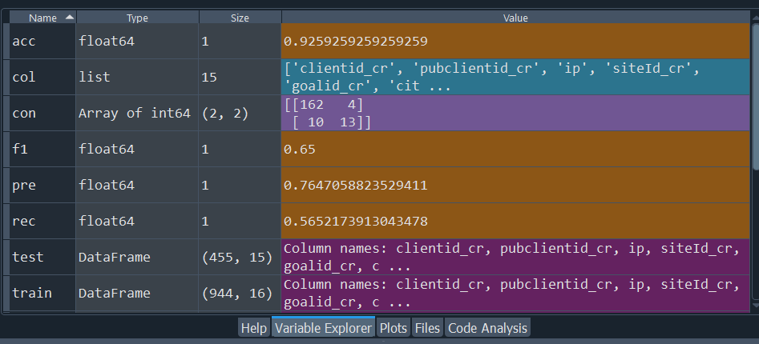
Demo/ Prototype

Slide 6
Approach
First step was to complete missing data, after that data preprocessing was completed.
Second step was to handle ip address as a feature, on which after reading some research paper I came to some conclusion and proceeded with that.
Third step was to classify the data for which I used Random Forest Classifier.

Slide 7
Technology Stack
Coding is performed on Spyder.
Conda is used as the package manager.
For data completion mainly pandas is used.
For handling ip address as a feature ipaddress package and regular expressions are used.
For data preprocessing pandas and scikit-learn is used.
For model training scikit-learn, numpy, counter and pandas are used.

Slide 8
Why our team is the best!
All the tasks performed and all coding done is by me.
This is a solo submission.
As for me I am in B. Tech 4th year UG to be.

Slide 9
Associated attachments/ files
1. all_data folder : It contains files provided by Hackathon.
2. data_compltn py file : It takes original file from all_data folder and after completing dataset saves them in comp_data folder.
3. comp_data folder : It contains the completed dataset.
4. ip_done py file : It takes completed dataset from comp_data folder and handles ip address then saves the file in handle_ip folder.
5. handle_ip folder : it contains the dataset with ip handled.
6. model py file : It takes the completed dataset from handle_ip and after classification saves the submission csv file.
7. final csv file : This is the submission file to be uploaded.

Slide 10
IMPORTANT INFO
The snapshot of the result provided is when the training data was split between train and validate sets.
However, the model used for the test set was trained on the whole training data.

Slide 11
Thank you

Slide 12
Appendix

Slide 13
Challenges
The key challenge I faced is how to handle ip address as a feature. It was something I neither handled before nor I cam across any problem of such type.
I solved the ip address problem with the help of a research paper I found by purdue university.
The research paper is included with my other file by the name of
“Encoding IP Address as a Feature for Network Intrusion Detection”.

